Slide 1

Skills for Success with Microsoft Office 2016 Volume 1
by Margo Chaney Adkins, Catherine Hain, Lisa Hawkins, and Stephanie Murre Wolf
Excel Chapter 3
Manage Multiple Worksheets
Notes:
Skills for Success with Microsoft Office 2016 Volume 1

Slide 2
Skills
Organize Worksheet Tabs
Enter and Format Dates
Clear Cell Contents and Formats
Move Cell Contents and Use Paste Options
Enter Data in Grouped Worksheets
Notes:
The skills of this chapter are:
Organize Worksheet Tabs
Enter and Format Dates
Clear Cell Contents and Formats
Move Cell Contents and Use Paste Options
Enter Data in Grouped Worksheets
The skills continue on the next slide.

Slide 3
Skills (cont.)
Insert Multiple Math Operators in Formulas
Format Grouped Worksheets
Insert, Hide, Delete, and Move Worksheets
Create Summary Worksheets
Create Clustered Bar Charts
Notes:
The skills of this chapter are:
Insert Multiple Math Operators in Formulas
Format Grouped Worksheets
Insert, Hide, Delete, and Move Worksheets
Create Summary Worksheets
Create Clustered Bar Charts

Slide 4
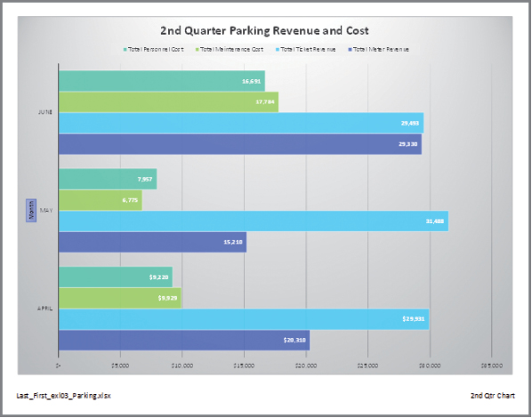
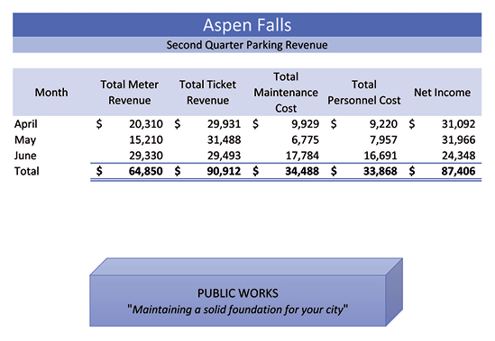

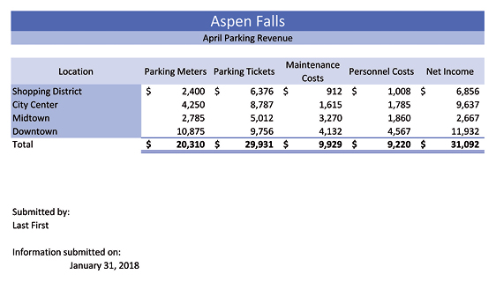
Introduction
Notes:
Once you go through the skills in this chapter, you will be able to create spreadsheets and charts like the ones shown here.

Slide 5
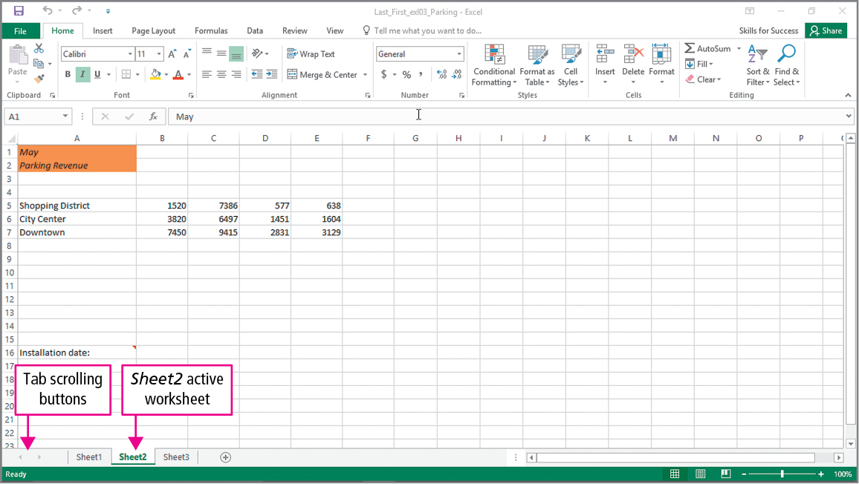
Skill 1: Organize Worksheet Tabs
Notes:
If your workbook contains more than one worksheet, you can move among them by clicking the worksheet tabs found on the bottom left of the Excel window. The tab scrolling button is used to display worksheet tabs that are not in view.

Slide 6
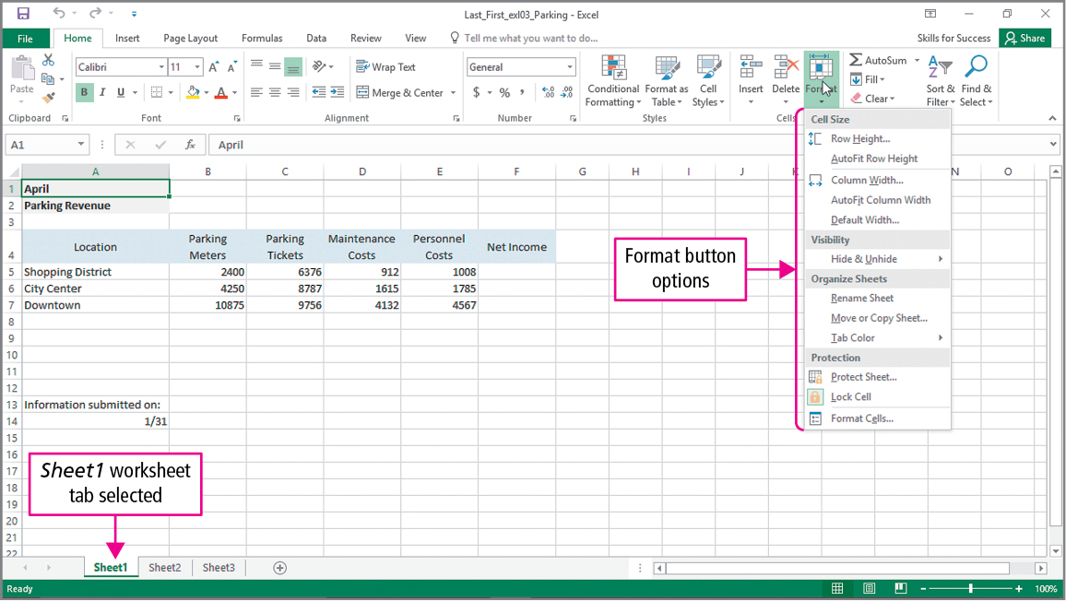
Skill 1: Organize Worksheet Tabs (cont.)
Notes:
The Rename Sheet option allows you to change the name of the worksheet to something more descriptive. Other formatting options are move, copy, and change the color of the tab sheet.

Slide 7
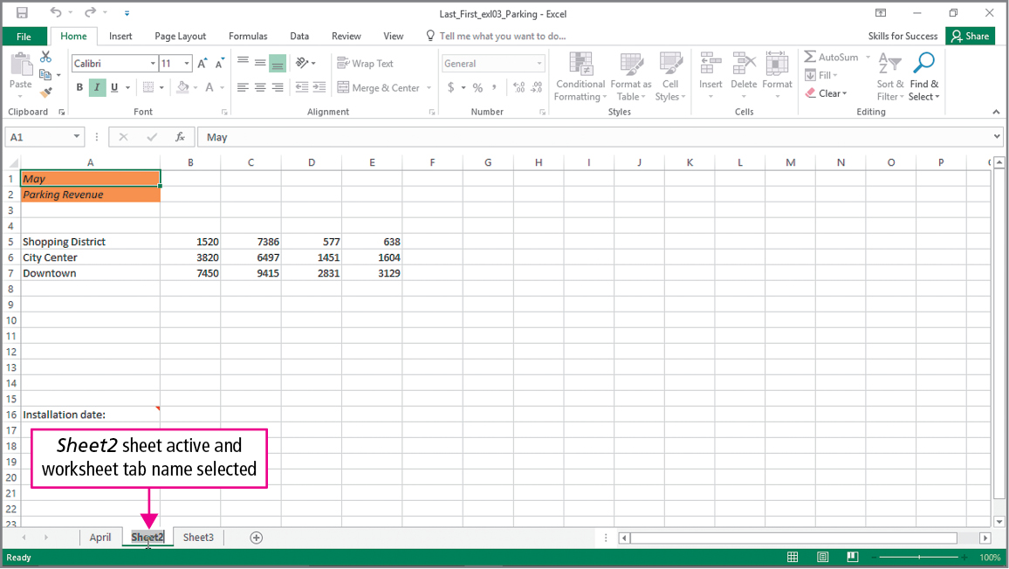
Skill 1: Organize Worksheet Tabs (cont.)
Notes:
You can also change the name of a worksheet by double-clicking on the worksheet’s tab and then typing the new name.

Slide 8
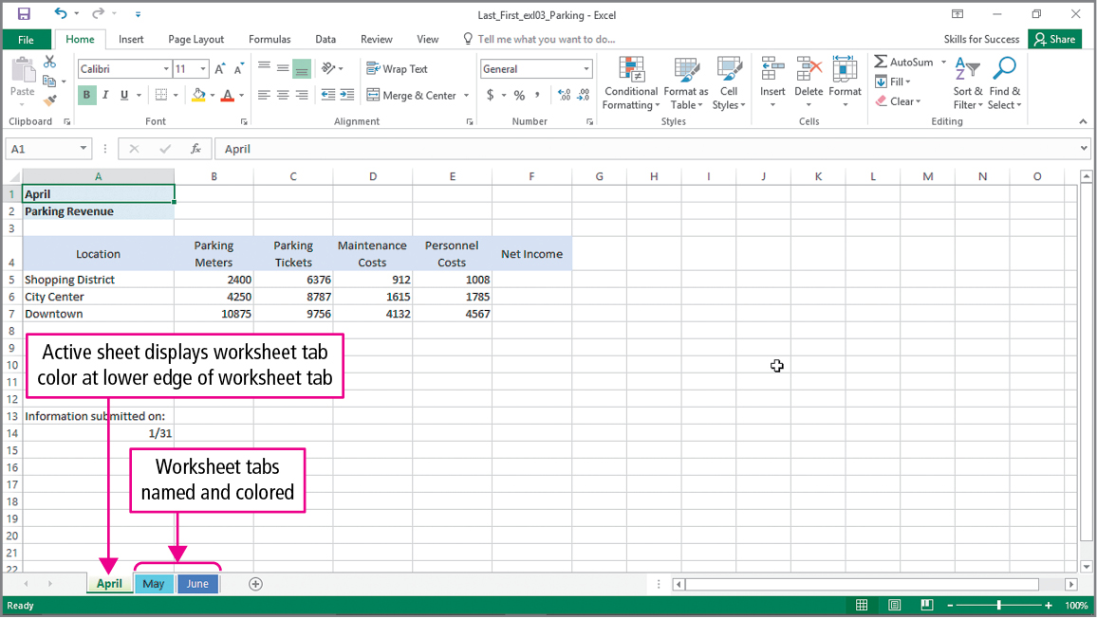
Skill 1: Organize Worksheet Tabs (cont.)
Notes:
When a tab color has been added, the active sheet will show the color at the lower edge of the worksheet tab. The inactive tab color will show the color in the entire tab. Here, you can see the Slipstream theme has been applied to the workbook, and the worksheet tabs have been named and colored.

Slide 9
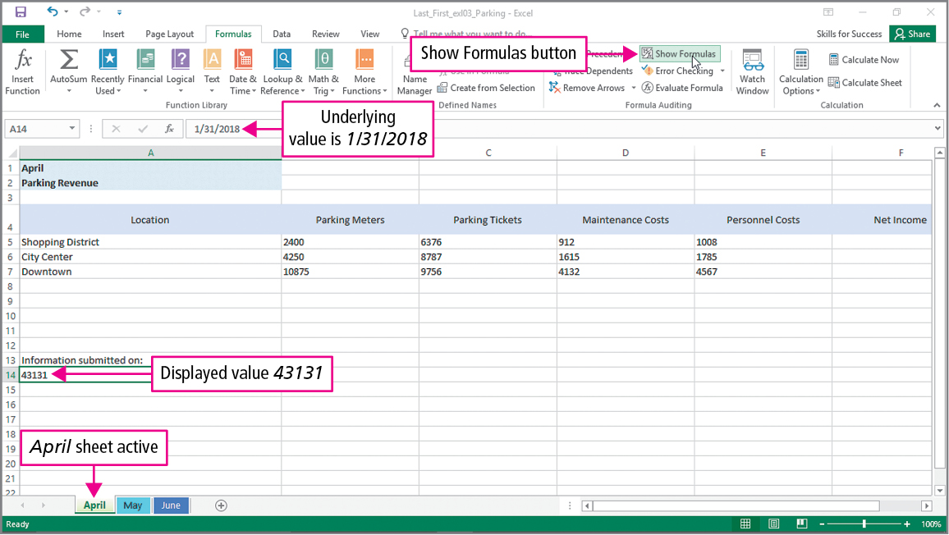
Skill 2: Enter and Format Dates
Notes:
When a date is entered into an Excel cell, it is assigned a serial number. This allows it to be used in calculations. Serial numbers for dates count the days since December 31, 1899. Dates can be entered in several different formats. Months can be entered using the entire name or just the first three characters. Years can be entered as two or four digits. If the year is omitted, it defaults to the current year.

Slide 10
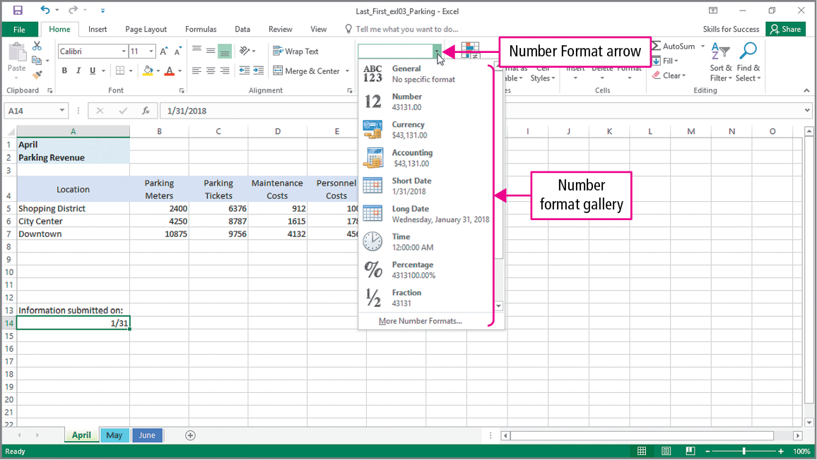
Skill 2: Enter and Format Dates (cont.)
Notes:
The Number Format gallery includes several common built-in number formats.

Slide 11
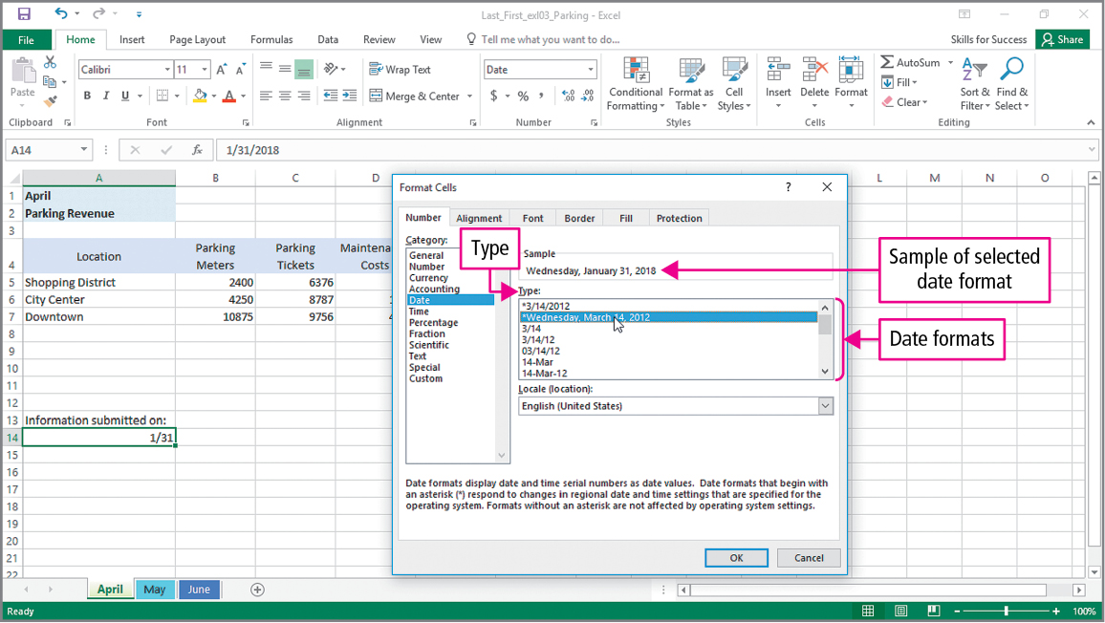
Skill 2: Enter and Format Dates (cont.)
Notes:
The Format Cells dialog has additional number format options—the result of applying the selected number format displays in the Sample box.

Slide 12
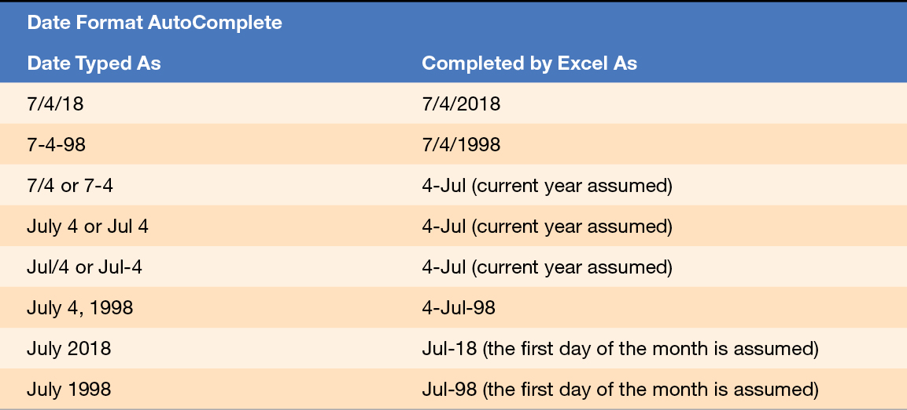
Skill 2: Enter and Format Dates (cont.)
Notes:
The table on this slide shows how different typed dates are completed by Excel.

Slide 13
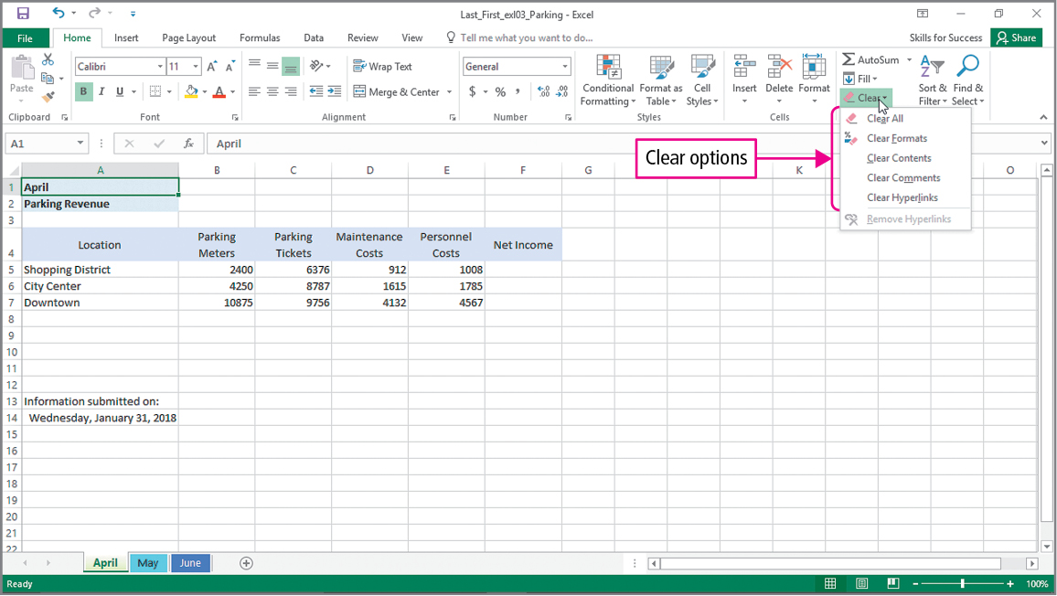
Skill 3: Clear Cell Contents and Formats
Notes:
Content refers to the underlying formulas and values found in a cell. Cells can also contain formatting, comments, and hyperlinks. You can clear formatting, comments, hyperlinks, or values from a cell.

Slide 14
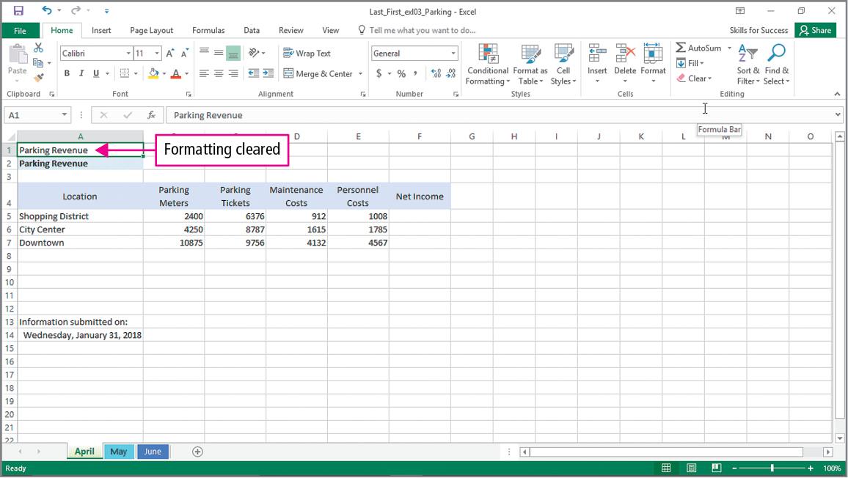
Skill 3: Clear Cell Contents and Formats (cont.)
Notes:
In the Editing group, the Clear button can be used to clear the formatting within a cell.

Slide 15
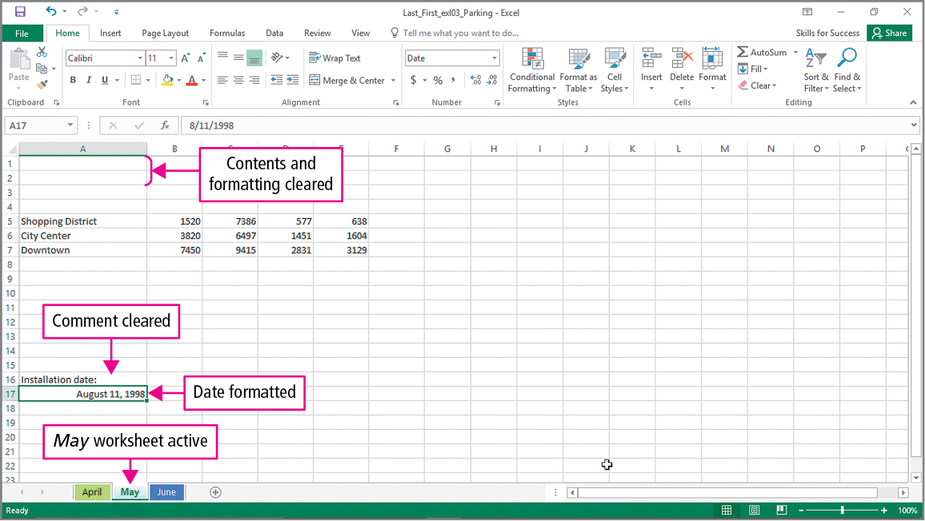
Skill 3: Clear Cell Contents and Formats (cont.)
Notes:
In the Editing group, the Clear button can also be used to clear contents and formatting within a cell or range of cells.

Slide 16
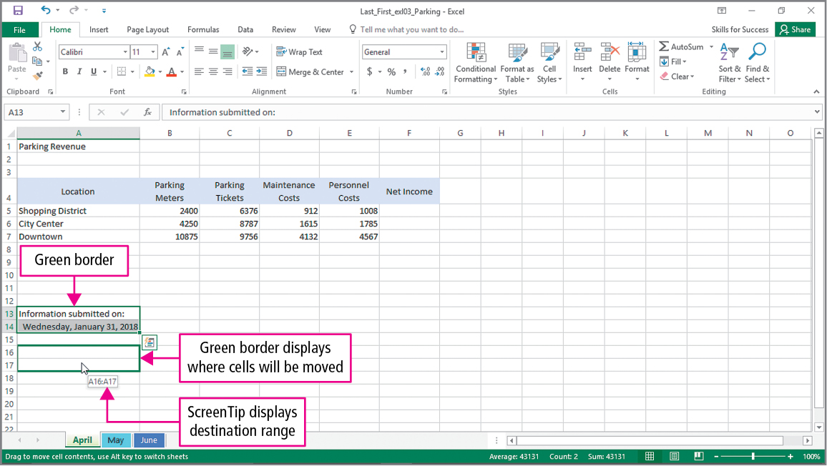
Skill 4: Move Cell Contents and Use Paste Options
Notes:
Drag and drop is a method of moving objects in which you point to the selection and drag it to a new location.

Slide 17
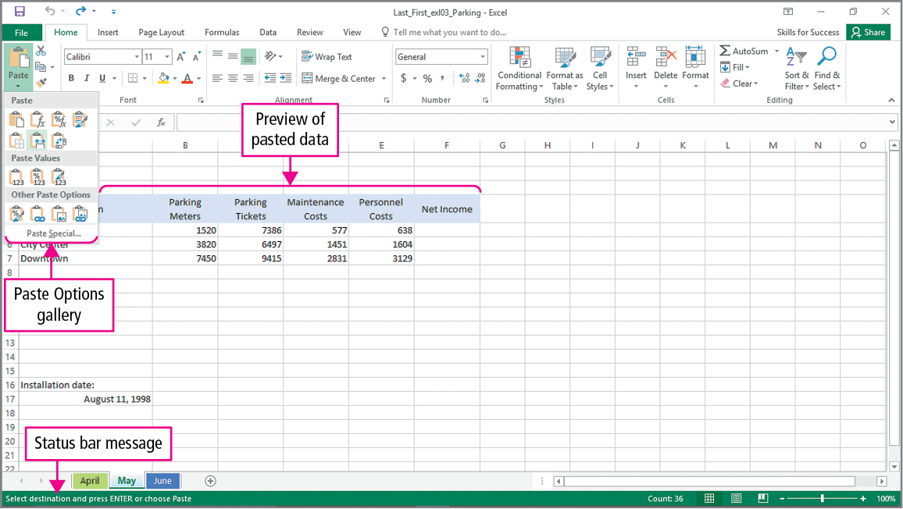
Skill 4: Move Cell Contents and Use Paste Options (cont.)
Notes:
Data from Excel cells can be copied or moved to other cells, other worksheets, or even other workbooks. When an item is copied or cut it is placed in a temporary storage area called the Clipboard.
The Live preview option allows you to see the results of each of the paste options.

Slide 18
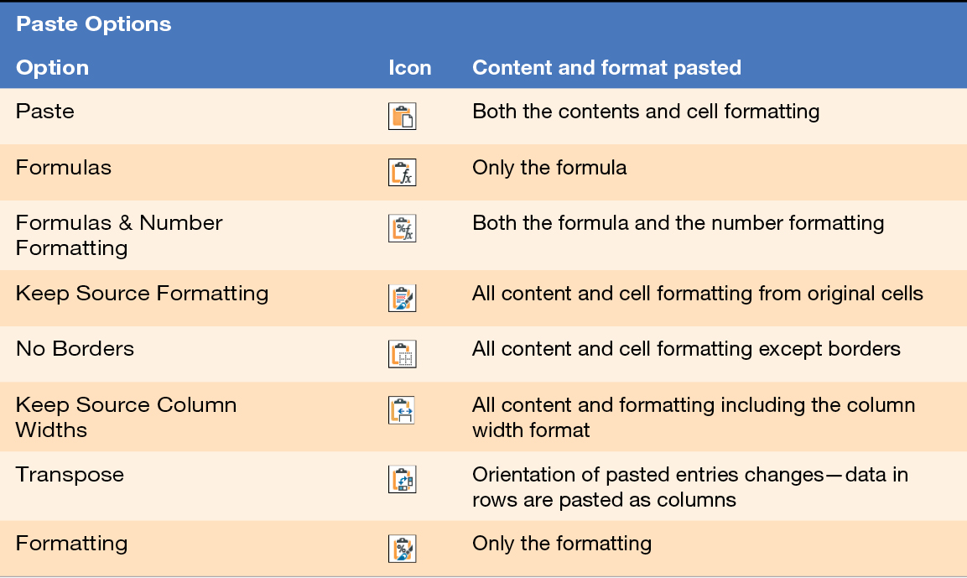
Skill 4: Move Cell Contents and Use Paste Options (cont.)
Notes:
This table summarizes all of the Paste Options. Notice that here are several choices for what will be pasted and what will not be applied to the new location.

Slide 19
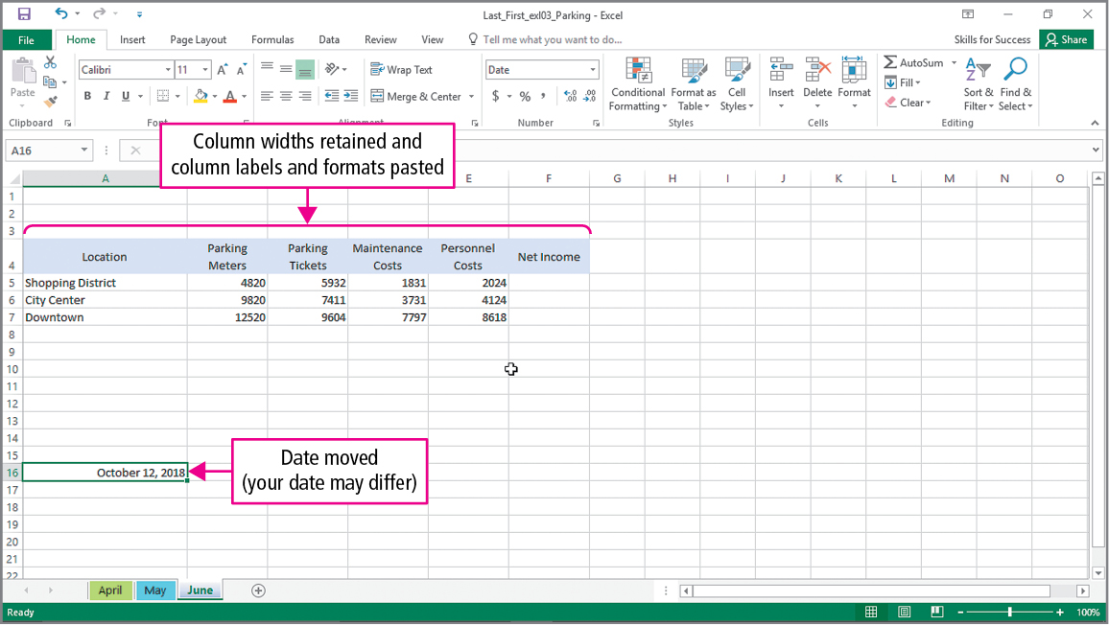
Skill 4: Move Cell Contents and Use Paste Options (cont.)
Notes:
When choosing your paste area, you only need to specify the upper left corner. Items that are pasted are not removed from the Clipboard.

Slide 20
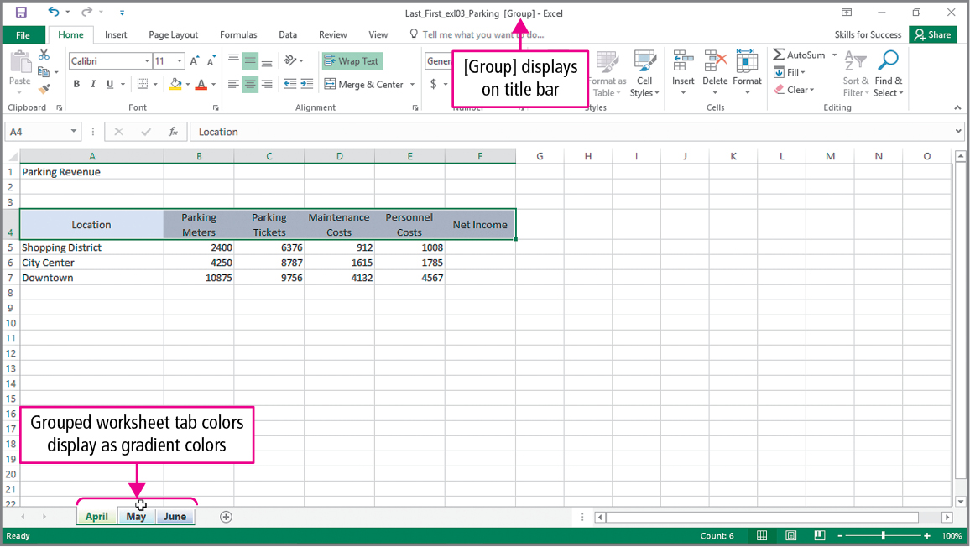
Skill 5: Enter Data in Grouped Worksheets
Notes:
Worksheets within a workbook can be grouped together. This can be useful when creating or modifying a set of worksheets that are similar in purpose and structure. Once the worksheets are grouped, you can edit data or format cells in all of the worksheets at the same time. This slide shows that the April, May, and June worksheets have been grouped together. Notice that Group displays in the title bar.

Slide 21
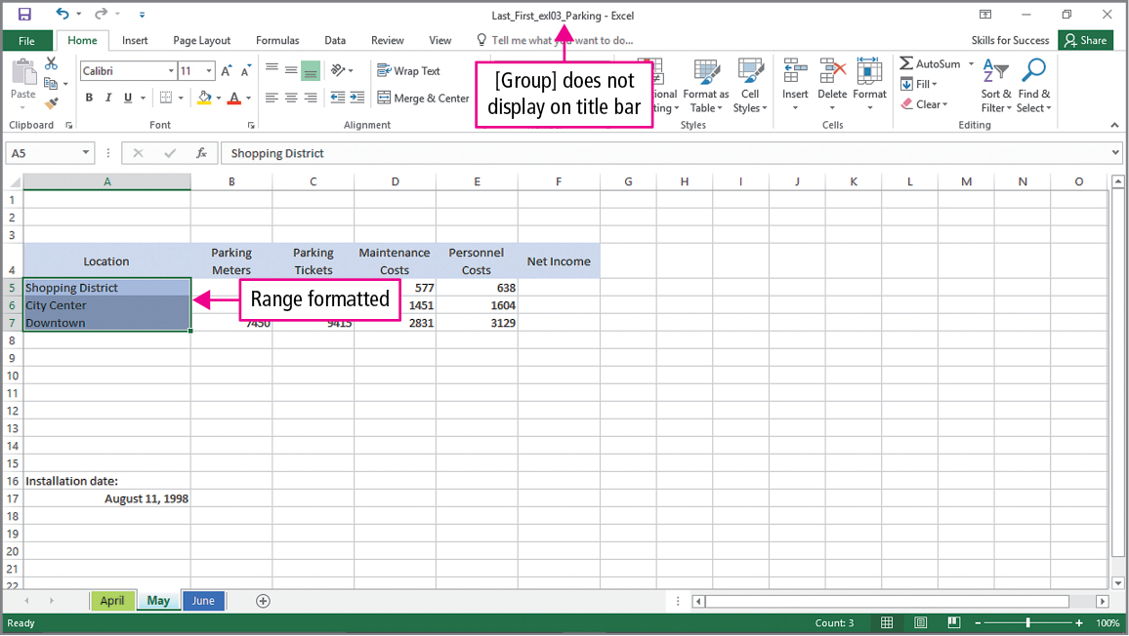
Skill 5: Enter Data in Grouped Worksheets (cont.)
Notes:
When the worksheets are not grouped, you can update the individual worksheet. As you can see here, Group no longer displays on the title bar, and the May worksheet is active.

Slide 22
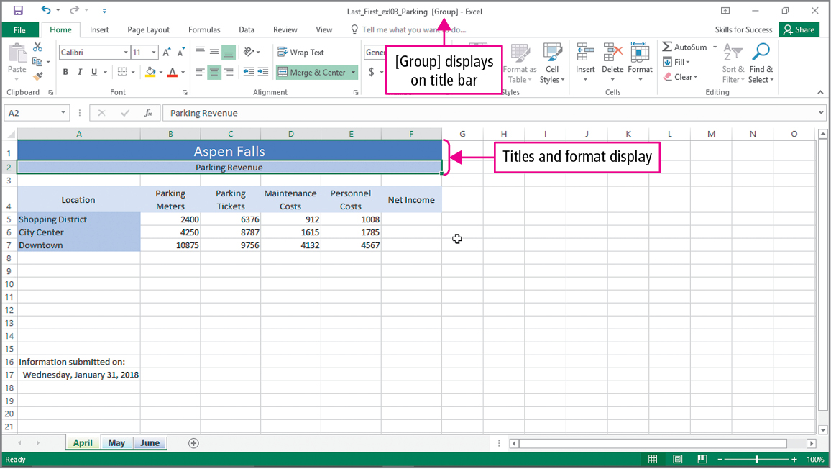
Skill 5: Enter Data in Grouped Worksheets (cont.)
Notes:
When the worksheets are grouped, anything that is done to one worksheet is reflected in the others. This would include the entering and formatting of titles.

Slide 23
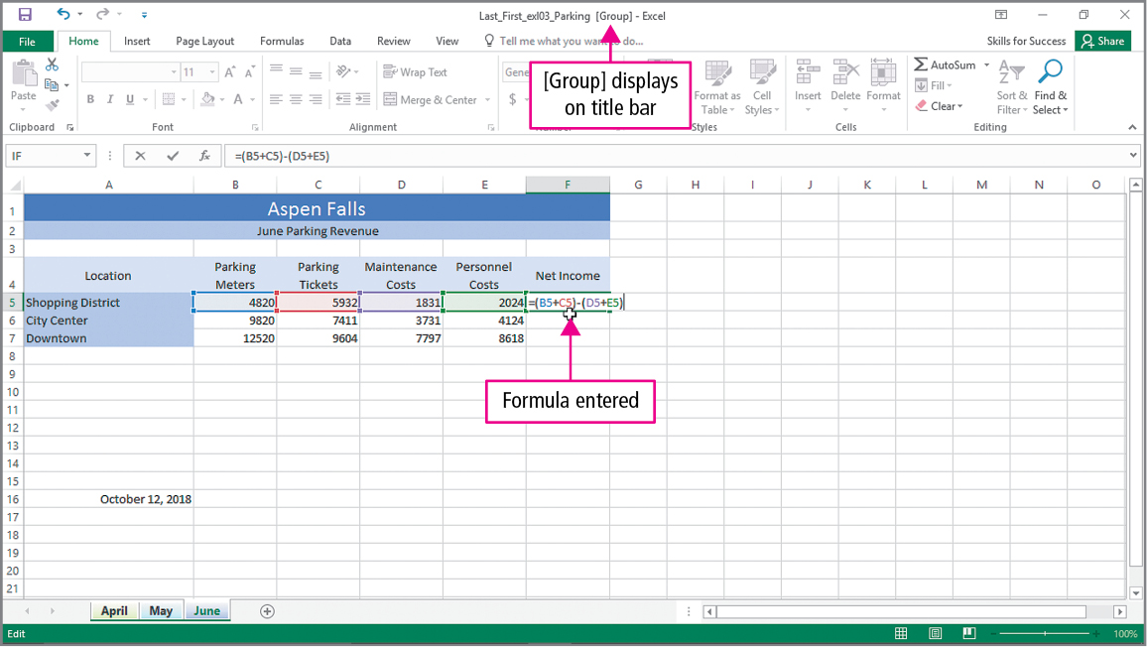
Skill 6: Insert Multiple Math Operators in Formulas
Notes:
In Excel, the operator precedence requires anything in parentheses is done first, then any multiplication and division, followed by addition and subtraction. If two operators have the same precedence, they are carried out from left to right. On this slide, the worksheets are being grouped before a formula is entered into cell F5.

Slide 24
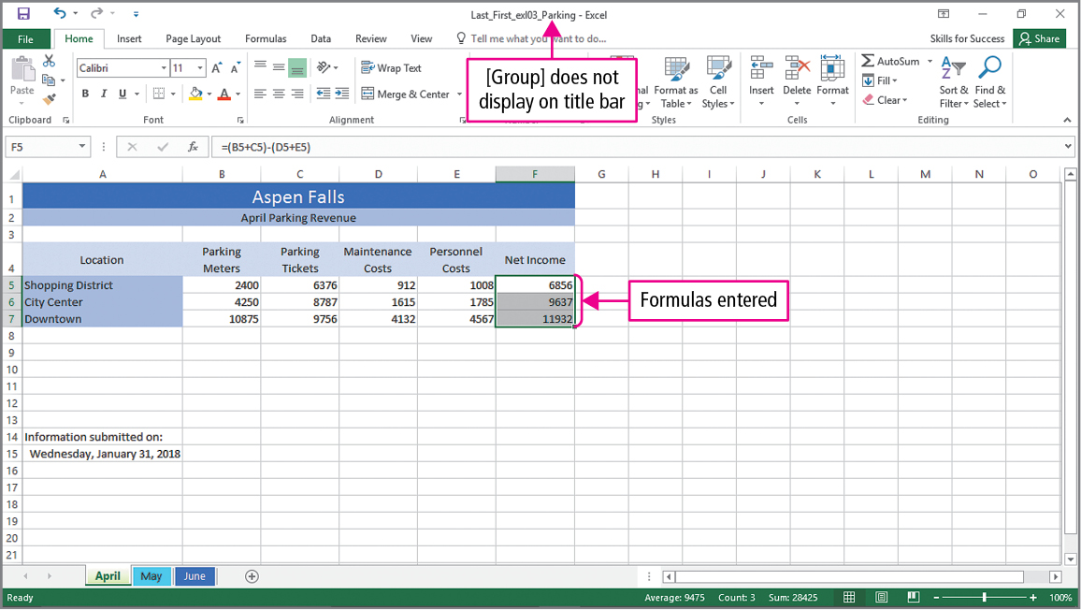
Skill 6: Insert Multiple Math Operators in Formulas (cont.)
Notes:
In this slide, the April worksheet is displayed, showing that the formulas entered when the worksheets were grouped are in this worksheet.

Slide 25
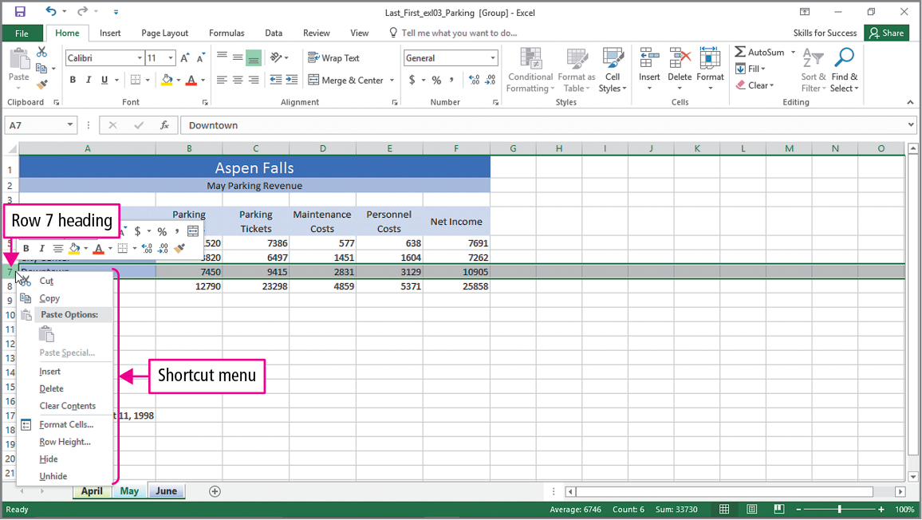
Skill 7: Format Grouped Worksheets
Notes:
Remember that when worksheets are grouped, anything you do - such as changing the width of a column - will be reflected in all worksheets in the group. This slide shows the beginning of the process of inserting a row into the grouped worksheets.

Slide 26
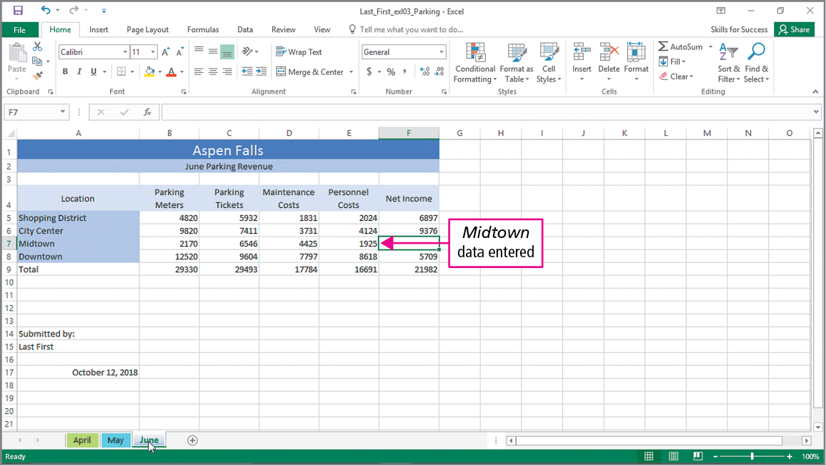
Skill 7: Format Grouped Worksheets (cont.)
Notes:
A row for Midtown has been added to each of the worksheets. The data has also been entered individually for each worksheet since the data will be different for each month.

Slide 27
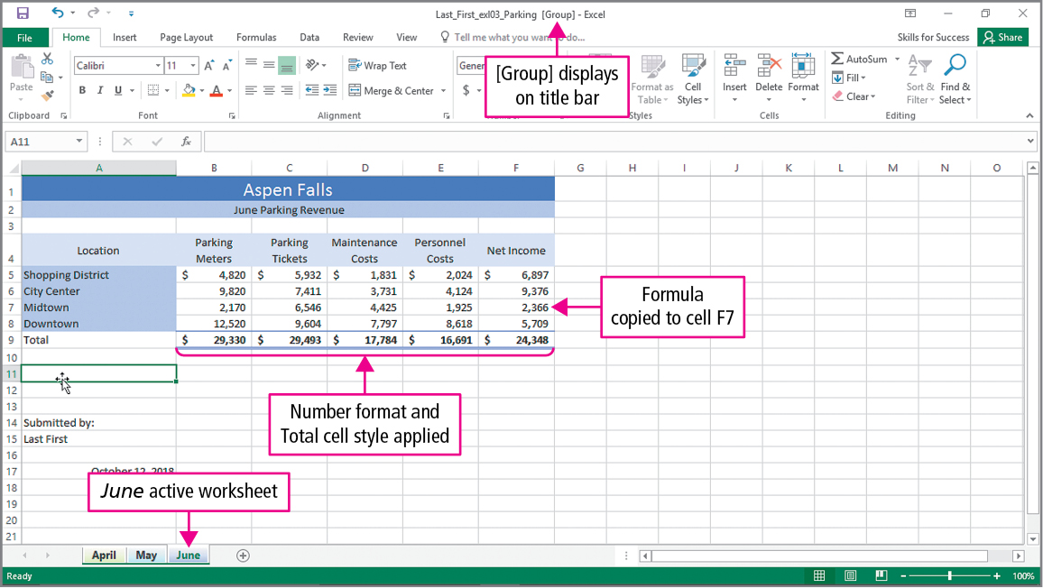
Skill 7: Format Grouped Worksheets (cont.)
Notes:
Changes to formatting are applied, and the formula is copied to cell F7 in all of the worksheets within the group.

Slide 28
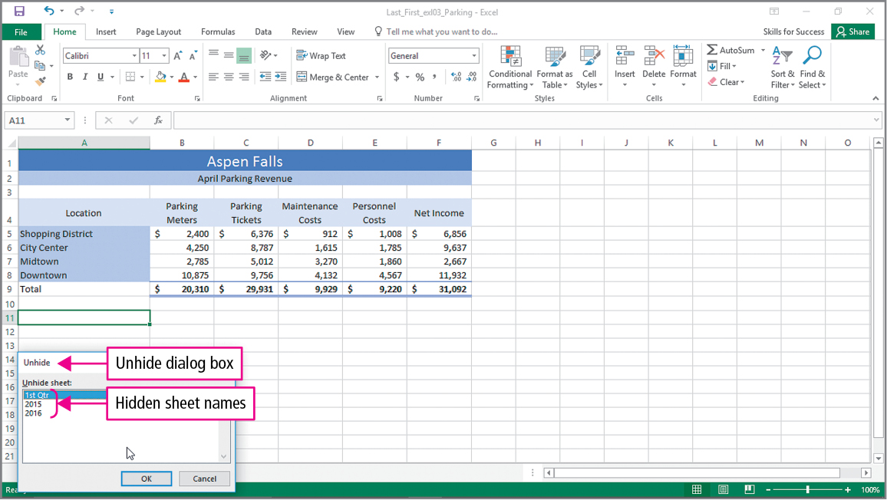
Skill 8: Insert, Hide, Delete, and Move Worksheets
Notes:
To organize a workbook, you can position worksheet tabs in any order. You can add new worksheets to accommodate new information, and hide worksheets that are not needed or that you do not want displayed.

Slide 29
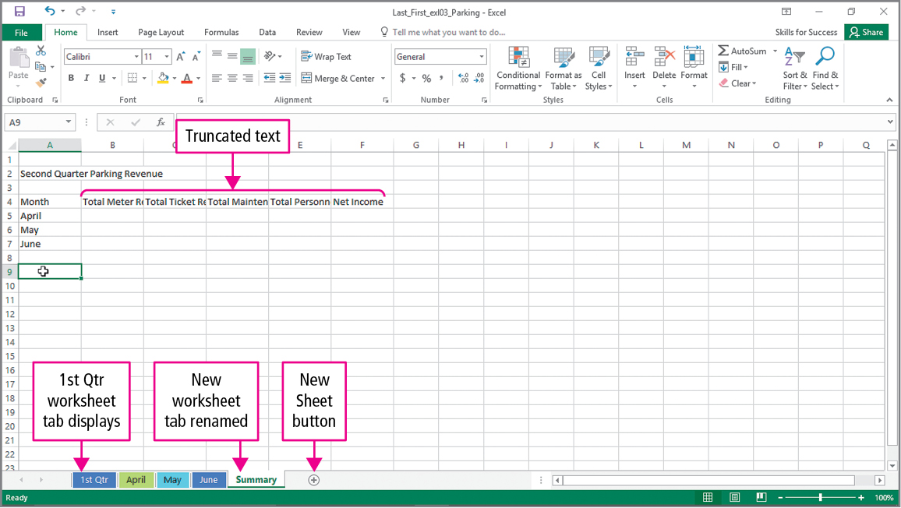
Skill 8: Insert, Hide, Delete, and Move Worksheets (cont.)
Notes:
While a worksheet can be deleted, you cannot undo the deletion. It is a good idea to always save your workbook before deleting a worksheet. The New Sheet button is used when you wish to add a worksheet to the workbook.

Slide 30
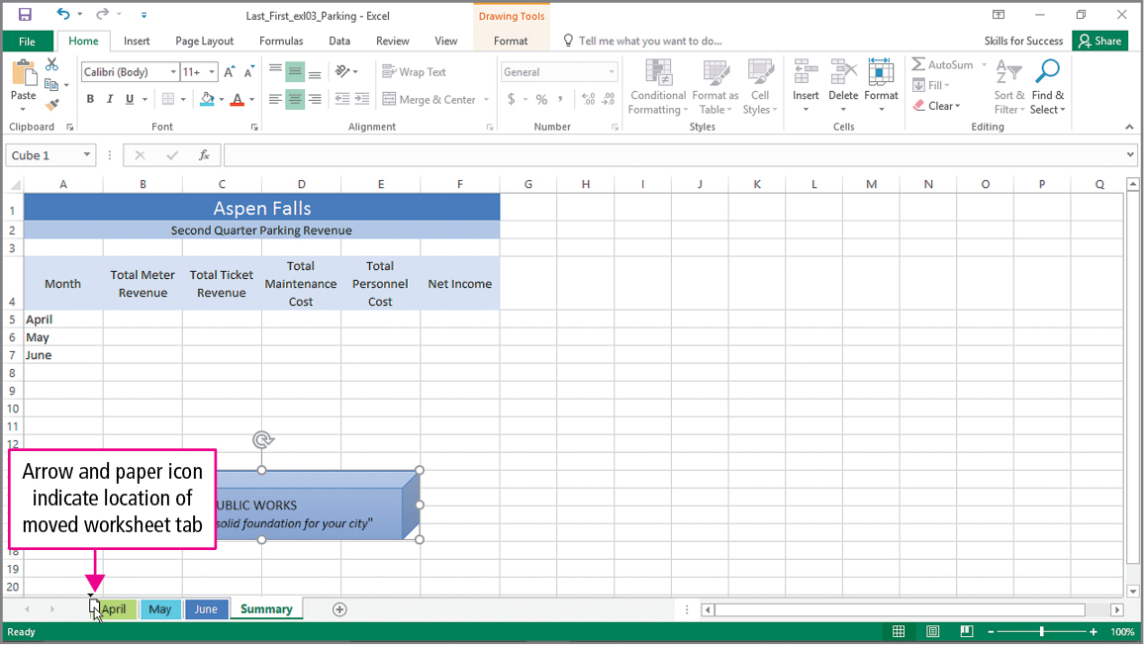
Skill 8: Insert, Hide, Delete, and Move Worksheets (cont.)
Notes:
You can move a worksheet by simply clicking and dragging its tab to the desired location within the worksheet tabs.

Slide 31
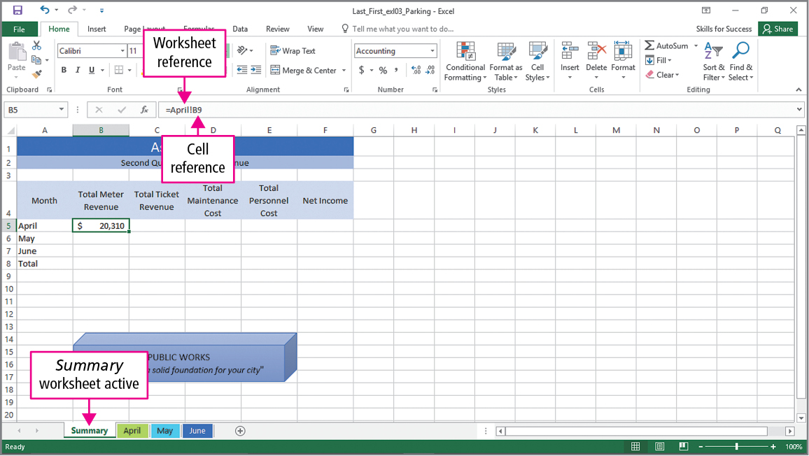
Skill 9: Create Summary Worksheets
Notes:
The summary sheet displays and summarizes totals from other sheets. This might be the yearly totals. A detail sheet is a worksheet with cells referred to by a summary sheet. This might be monthly results. Formulas may contain worksheet references and cell references. The active cell in this worksheet is getting its value from cell B9 in the April worksheet.

Slide 32
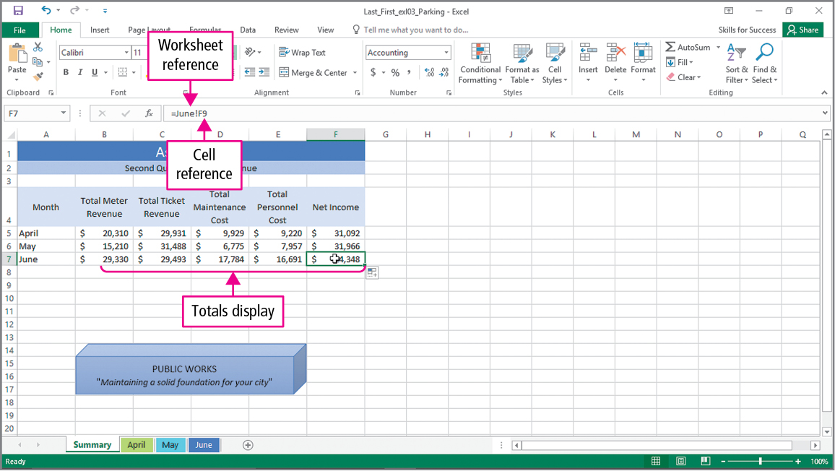
Skill 9: Create Summary Worksheets (cont.)
Notes:
Values changed in the detail worksheets are reflected in the summary worksheet.

Slide 33
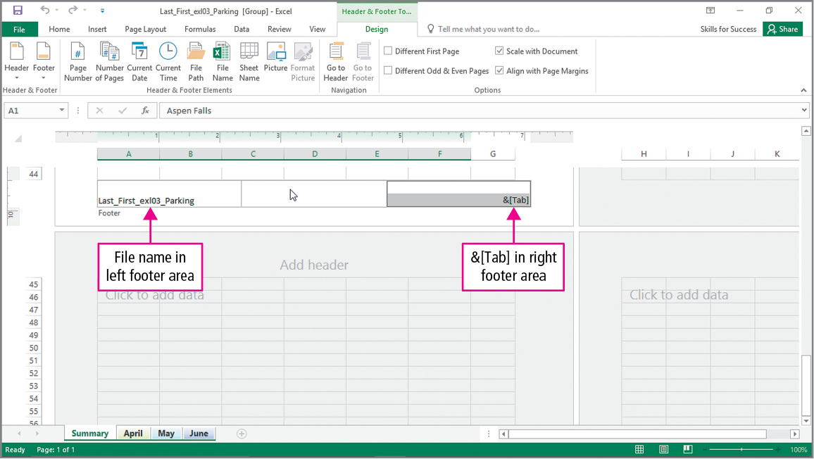
Skill 9: Create Summary Worksheets (cont.)
Notes:
When the worksheets are grouped, headers and footers that are created will apply to all of the worksheets.

Slide 34
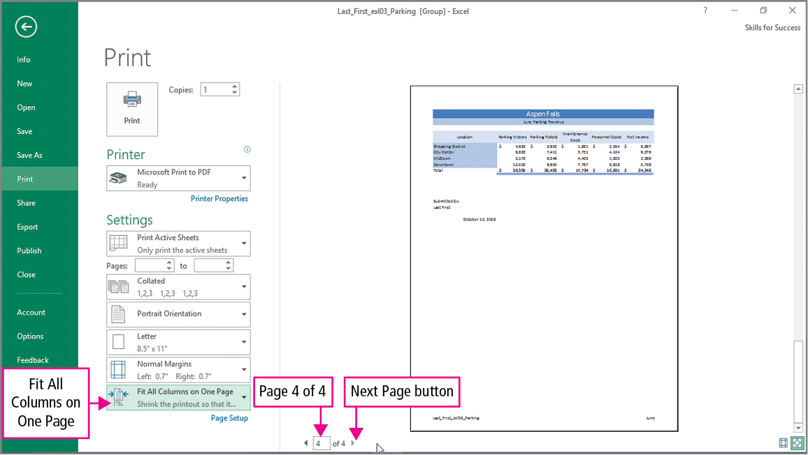
Skill 9: Create Summary Worksheets (cont.)
Notes:
With the worksheets still grouped, all of them will be printed. Notice the slide indicates that four pages will be printed.

Slide 35
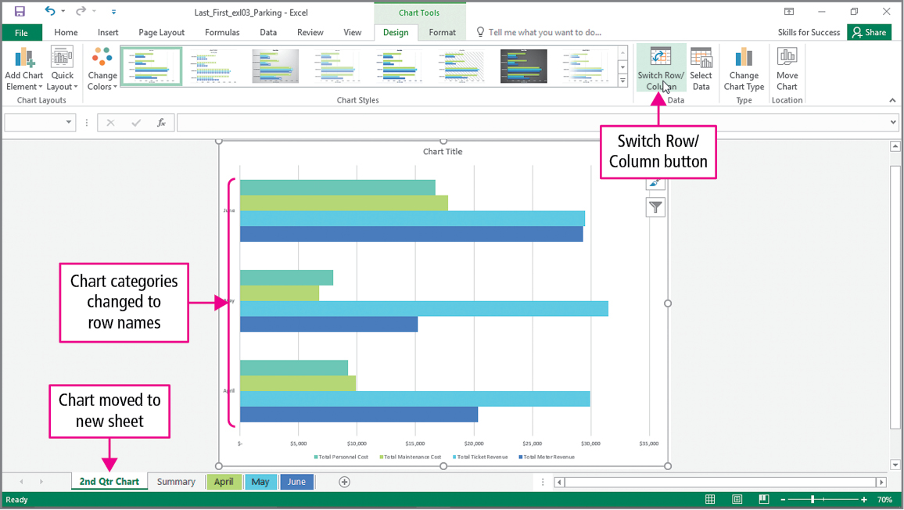
Skill 10: Create Clustered Bar Charts
Notes:
A clustered bar chart organizes categories along the vertical axis and values along the horizontal axis. Displaying the data in this chart type is useful as we want to look at revenue and cost by month.

Slide 36
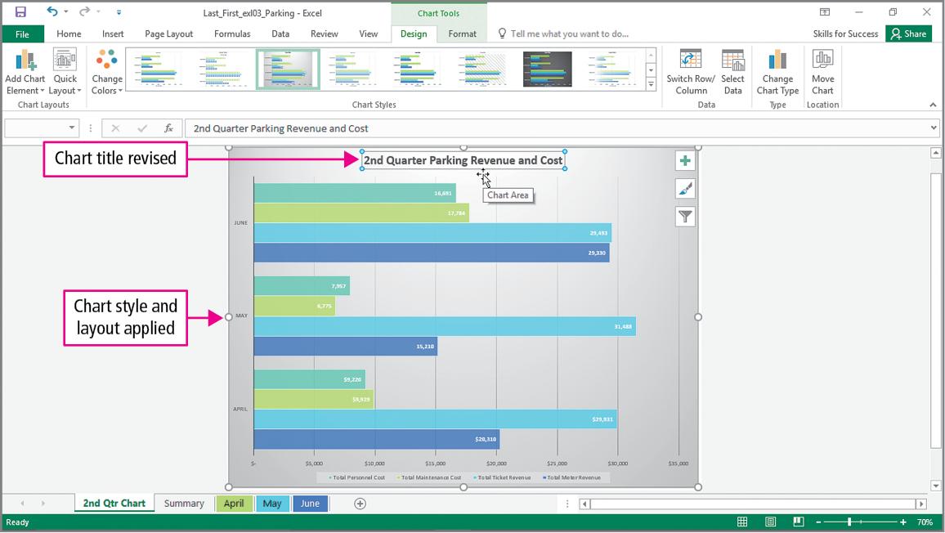
Skill 10: Create Clustered Bar Charts (cont.)
Notes:
This slide shows the Chart title and Chart styles being applied to the chart.

Slide 37
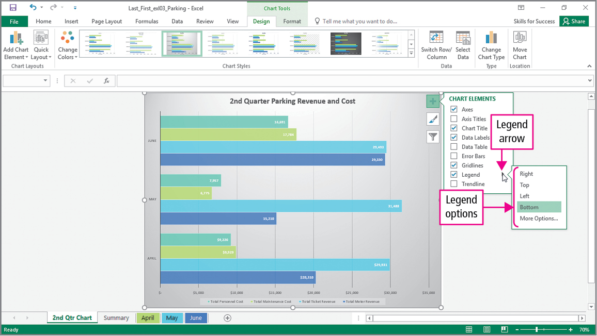
Skill 10: Create Clustered Bar Charts (cont.)
Notes:
A chart legend can be added, removed, or moved by clicking the Chart Elements, pointing to the Legend arrow, and then selecting the Legend option.

Slide 38
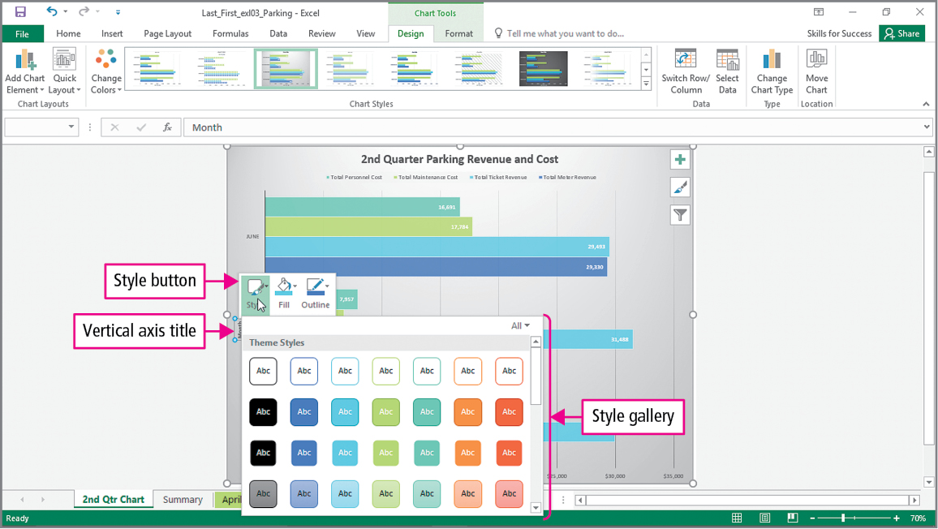
Skill 10: Create Clustered Bar Charts (cont.)
Notes:
This slide shows the vertical axis title being changed and a style being applied to the chart.

Slide 39
More Skills For Success
You will now practice the following additional skills:
Create SmartArt Organization Charts
Create and Insert Screen Shots
Modify the Quick Access Toolbar
Create and Edit Hyperlinks
Notes:
The More Skills for Success in this chapter will show you how to:
Create Smart Organization Charts
Create and Insert Screen Shots
Modify the Quick Access Toolbar
Create and Edit Hyperlinks

Slide 40
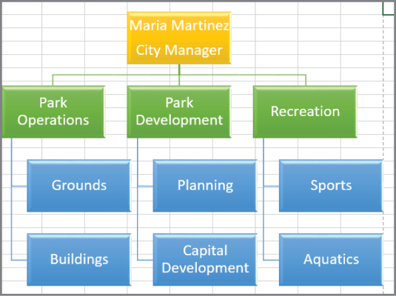
More Skills 11: Create Organization Charts
Notes:
An organization chart graphically shows the hierarchy of relationships between individuals and groups within an organization. A SmartArt graphic provides a visual representation of information used to effectively communicate ideas. You can create organization charts with Excel’s SmartArt tool. When creating an organization chart, you can type either in the text pane or directly in the SmartArt graphic shapes.

Slide 41
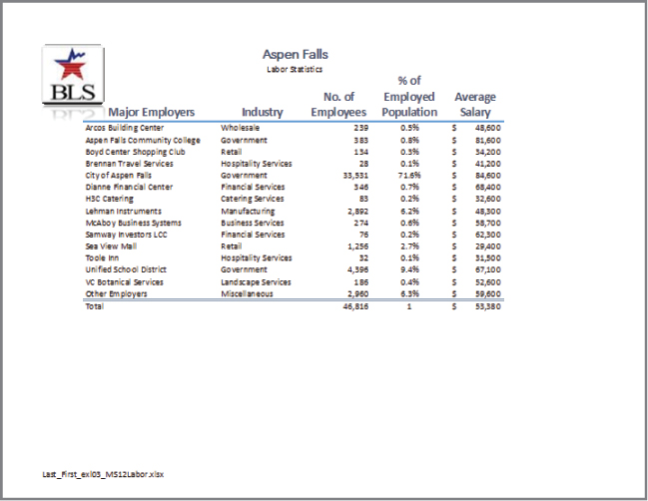
More Skills 12: Create and Insert Screen Shots
Notes:
A screen shot is an image of the computer screen. A screen clipping is a picture of the computer screen that can be inserted into a worksheet. It can be any size you want. To insert a screen shot or clipping into a worksheet, on the Insert tab, in the Illustrations group, click Take a Screenshot.

Slide 42
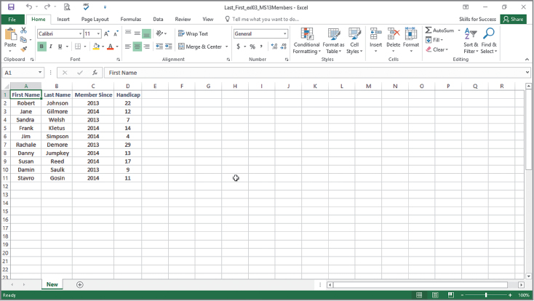
More Skills 13: Modify the Quick Access Toolbox
Notes:
The Quick Access Toolbar is a small toolbar that contains buttons for commonly used commands such as Save and Undo. You can customize the Quick Access toolbar to add buttons for commonly used actions, such as Print Preview and Print.

Slide 43
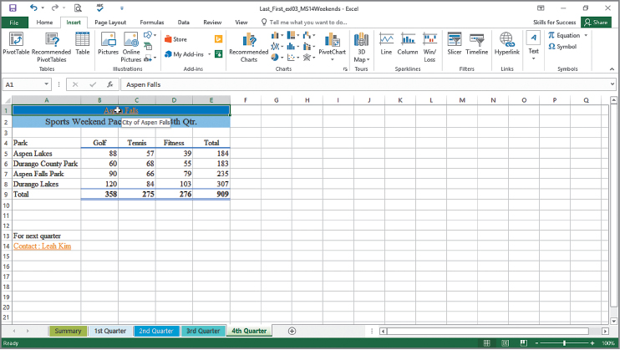
More Skills 14: Create and Edit Hyperlinks
Notes:
Hyperlinks allow you to create links to other files, locations in files, or web pages. Once a hyperlink is entered into Excel, you can edit or delete it. As you enter hyperlinks, Excel will try to assist you by entering the names of websites you have previously visited.
Hyperlinks change color after you visit the site. The Screen Tip dialog box allows you to enter text that will display when you point at the link.

Slide 44
Summary
In this chapter you have learned to:
Organize Worksheet Tabs
Work with Grouped Worksheets
Create Summary Worksheets
Create Clustered Bar Charts
Notes:
In this chapter you have learned how to:
Organize Worksheet Tabs
Enter and Format Dates
Clear Cell Contents and Formats
Move Cell Contents and Use Paste Options
Enter Data in Grouped Worksheets
Insert Multiple Math Operators in Formulas
Format Grouped Worksheets
Insert, Hide, Delete, and Move Worksheets
Create Summary Worksheets
Create Clustered Bar Charts

Slide 45
Questions
Notes:
As you complete this introduction to Excel, be sure you ask questions. You want to understand the concepts so that you can continue to build on them in future chapters.

Slide 46

Copyright
All rights reserved. No part of this publication may be reproduced, stored in a retrieval system, or transmitted, in any form or by any means, electronic, mechanical, photocopying, recording, or otherwise, without the prior written permission of the publisher. Printed in the United States of America.

